Slide 1

Exploratory Data Analysis
G2M Project for Data Analysts Internship
June 20th ,2023
Haoyue Chang

Slide 2


Content
Executive Summary
Problem Statement
Approach
EDA
Hypothesis
Recommendations

Slide 3
Executive Summary
XYZ, a private equity firm based in the United States, intends to invest in the Cab Industry due to its significant expansion in recent years and the presence of several prominent competitors in the market.
Four datasets overall
- Cab_Data: 7 columns and 359,392 rows, consisting of float64(3), int64(2), and object(2) data types.
- Customer_ID: 4 columns and 49,171 rows, consisting of int64(3) and object(1) data types.
- Transaction_ID: 3 columns and 440,098 rows, consisting of int64(2) and object(1) data types.
- City: 3 columns and 20 rows, consisting of object(3) data types.

Slide 4

Problem Statement
Help XYZ company to choose a proper company to make an investment in Cab industry

Slide 5

Approach
Data Loading
Data Exploration
Data Merging
Exploratory Data Analysis (EDA) & Hypothesis

Slide 6
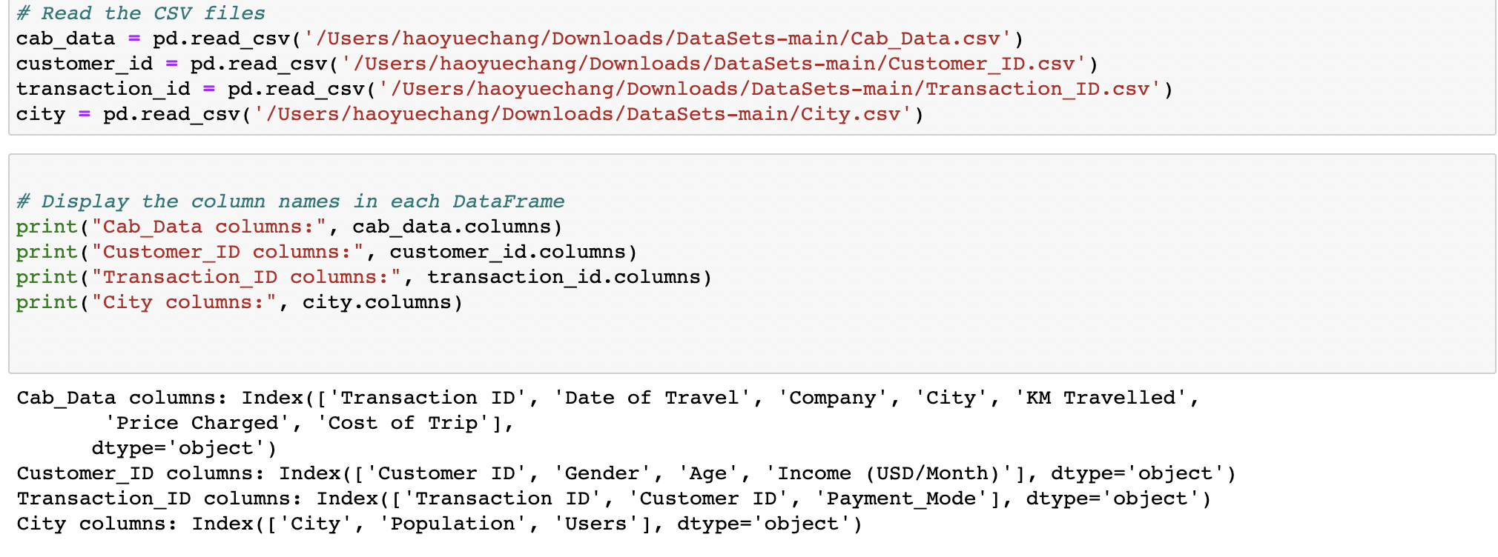
Data Loading
Cab_Data contains ‘Transaction ID’, ‘Date of Travel’, ‘Company’, ‘City’, ‘KM Travelled’, ‘Price Charged’, ‘Cost of Trip’
Customer_ID contains 'Customer ID', 'Gender', 'Age', 'Income (USD/Month)'
Transaction_ID contains 'Transaction ID', 'Customer ID', 'Payment_Mode'
City contains 'City', 'Population', 'Users'

Slide 7
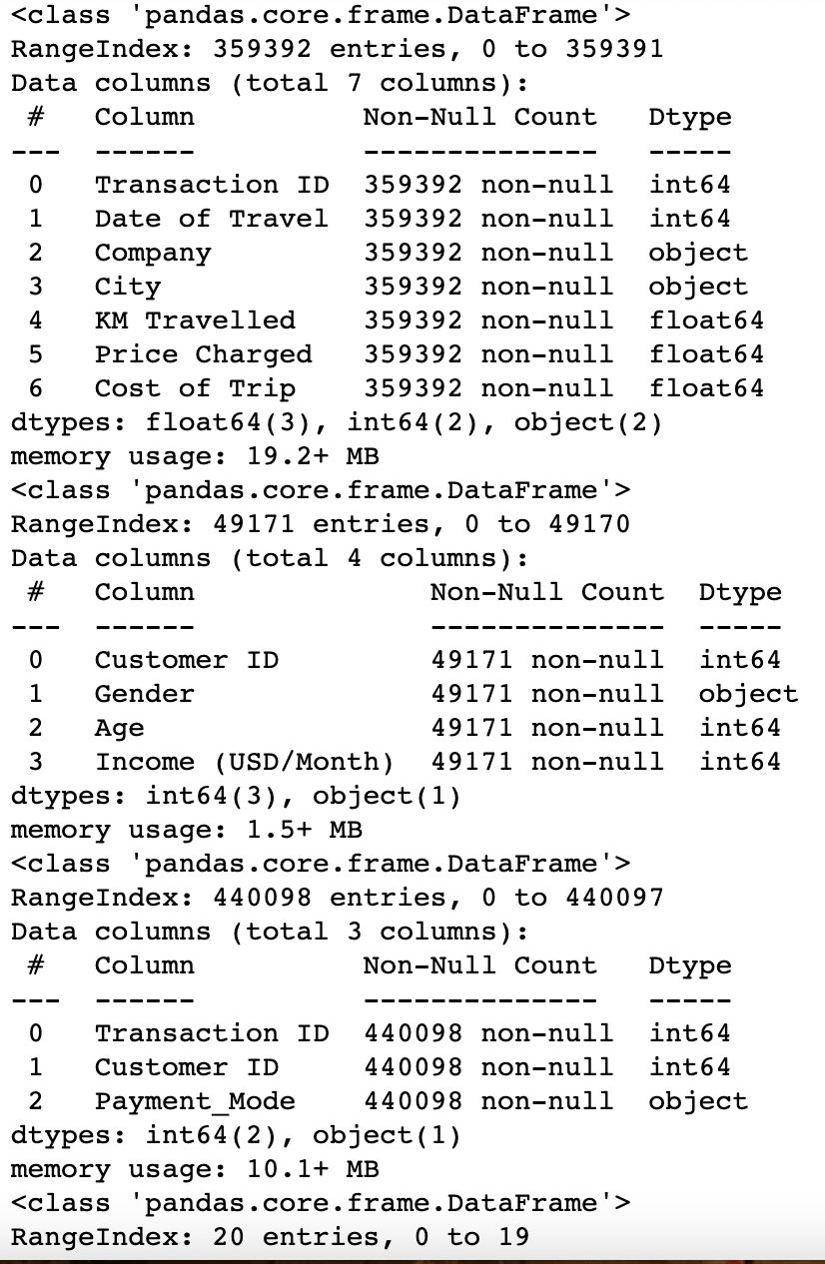
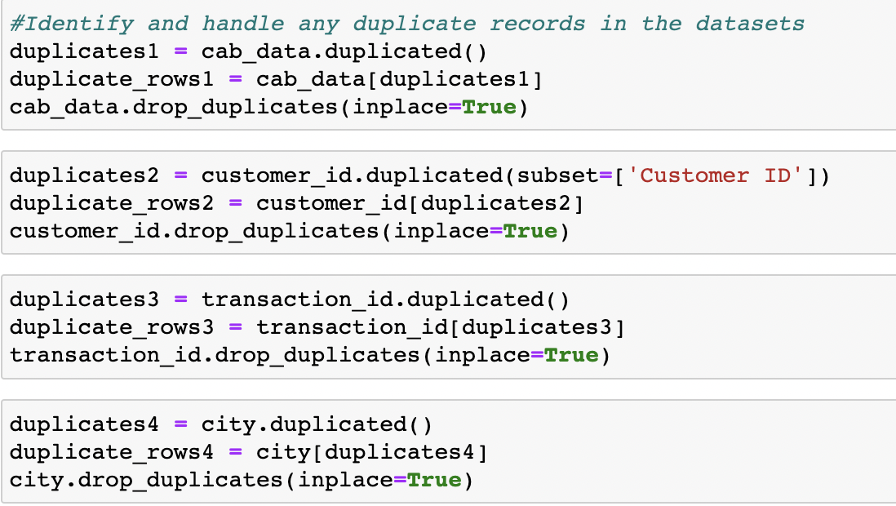
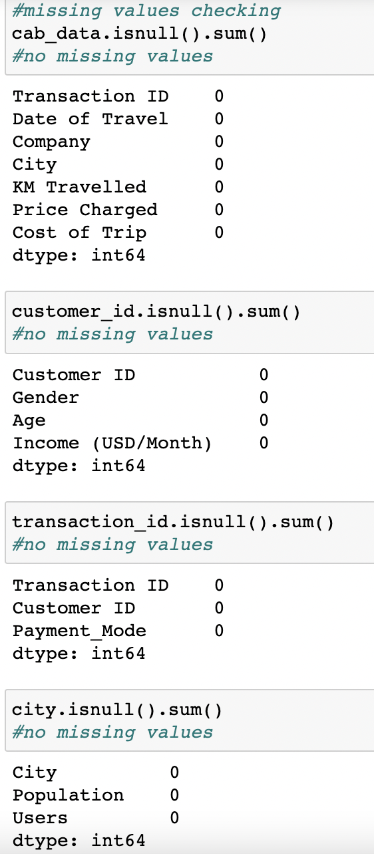
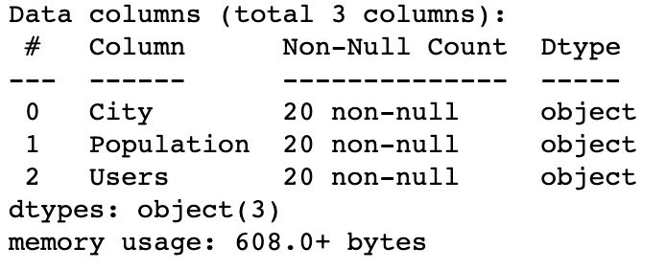
Data Exploration
cab_data:7 columns and 359392 rows,float64(3), int64(2), object(2);
customer_id:4 columns, 49171 rows, int64(3), object(1)
transaction_id:3 columns, 440098 rows, int64(2), object(1)
city:3 columns, 20 rows, object(3)
No missing values in all four datasets
Dropped duplicates in datasets

Slide 8
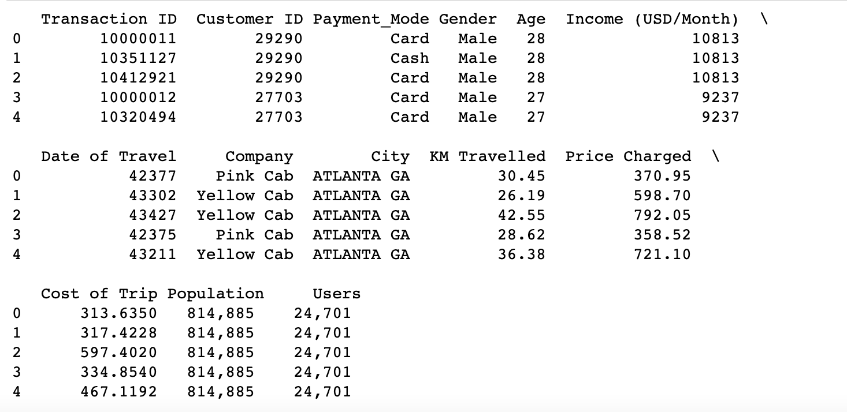
Data Merging
Datasets were merged based on common columns to create a consolidated dataset for analysis
Merged Transaction_Id.csv with Customer_ID.csv based on Customer ID
Merged the new data with Cab_data.csv based on Transaction ID
Merged the new data with City.csv based on City

Slide 9
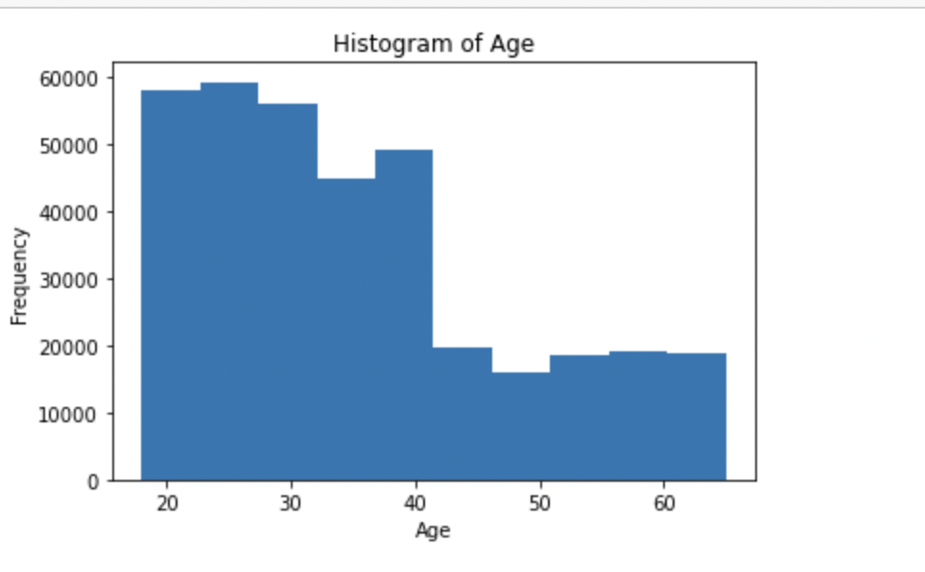
EDA
The distribution of ages appears to be skewed towards the younger age range, indicating a potential trend of younger individuals utilizing cab services more frequently compared to older age groups.
A significant portion of the cab users in the dataset falls within the younger age brackets.

Slide 10
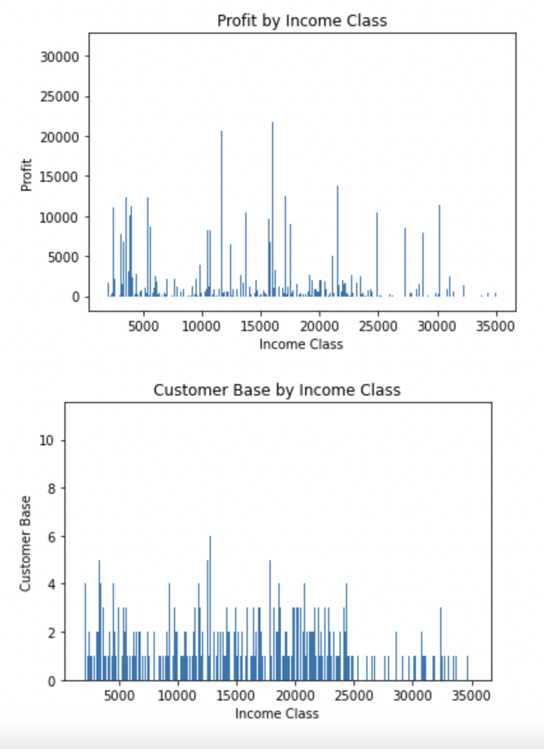
EDA
The bar plot shows the distribution of profit across different income classes.
Higher income classes tend to generate higher profits, as indicated by the taller bars for higher income classes.
The bar plot illustrates the distribution of the customer base across income classes.
The bars represent the number of unique customers in each income class.

Slide 11
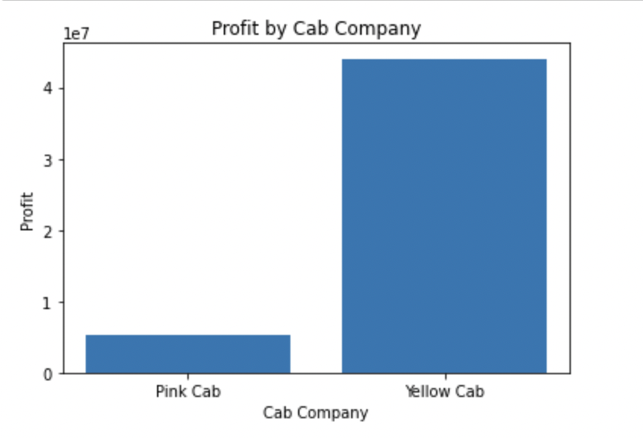
Hypothesis 1: Profitability varies based on the cab company
The bar plot visualizes the profit by the cab company
X-axis represents the cab companies
Y-axis represents the profit
It is evident that profitability does vary based on the cab company

Slide 12
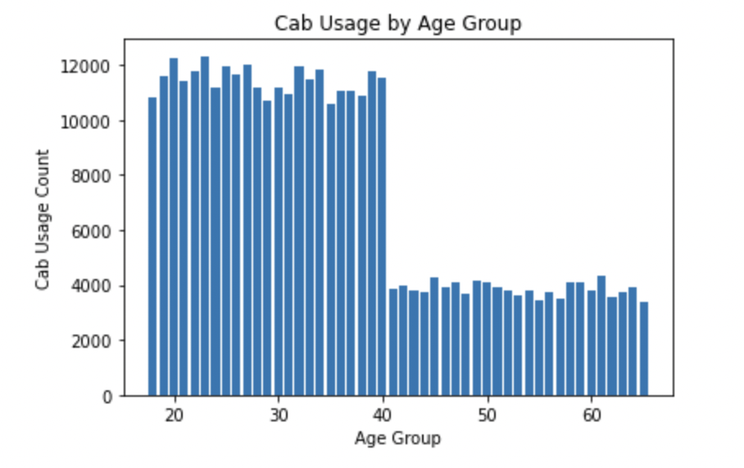
Hypothesis 2: Customer demographics impact cab usage
The bar plot visualizes the profit by the cab company
X-axis represents the cab companies
Y-axis represents the profit
It is evident that profitability does vary based on the cab company

Slide 13
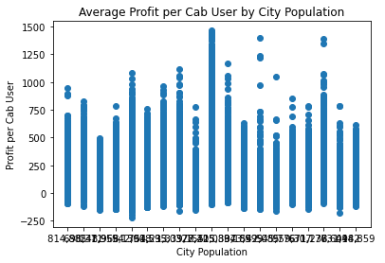
Hypothesis 3:Average profit per cab user varies by city population
There is no clear pattern or trend indicating a strong relationship between city population and average profit per cab user
There is no significant correlation or variation between city population and average profit per cab user.

Slide 14
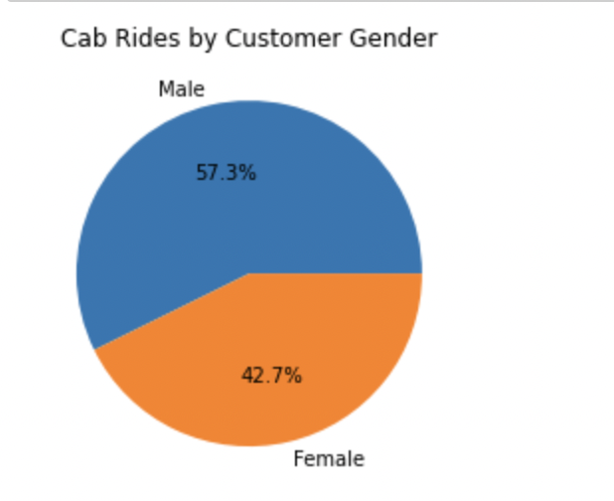
Hypothesis 4: per cab user by customer gender
It is evident that cab rides do vary based on customer gender

Slide 15
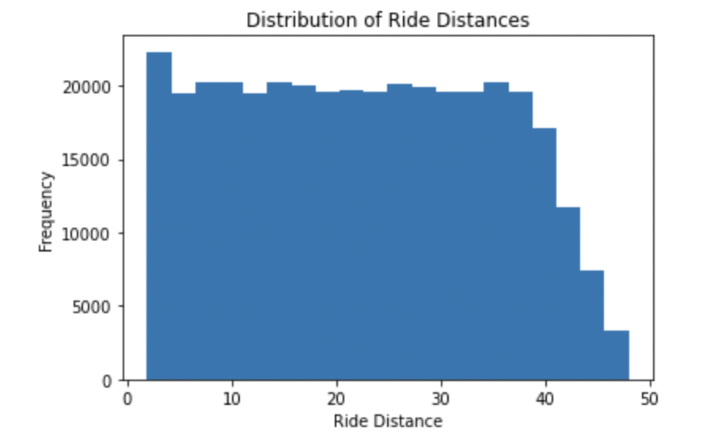
Hypothesis 5: Customer analysis varies based on ride distance
X-axis represents the ride distance, divided into different bins,
Y-axis represents the frequency or count of ride distances falling within each bin.
We can gain an understanding of the spread and concentration of ride distances

Slide 16
Recommendation
Cab Company Profitability: It's clear that profitability varies among cab companies. XYZ firm should invest in companies that have shown higher profitability.
Customer Demographics and Usage: Demographic factors like age and gender impact cab usage. XYZ firm should customize marketing strategies and services to cater to specific customer segments.
Customer Preferences and Ride Distance: Ride distances reveal valuable insights into customer preferences. XYZ firm should use this information to optimize operations and service offerings.
Exploring New Markets: The analysis highlights untapped potential among certain income groups. XYZ firm should target these segments by offering tailored services, discounts, or loyalty programs.
Continuous Data Analysis: Regularly analyzing data and monitoring market trends, customer preferences, and competition is crucial for XYZ firm to make informed investment decisions and identify emerging opportunities.
Strategic Partnerships and Acquisitions: XYZ firm can consider forming strategic partnerships or acquiring cab companies that align with their investment goals and have a strong market presence. This can facilitate expansion, access to new customer segments, and synergistic growth.

Slide 17

Thank you

